Slide 1
5.3 Cybersecurity
Cybersecurity threats – Social engineering

Slide 2





Social engineering threats
The art of manipulating people so they give up confidential information.
Pharming
Blagging (pretexting)
Baiting
Quid pro quo
Phishing
Mentioned in the syllabus
Not mentioned in the syllabus

Slide 3
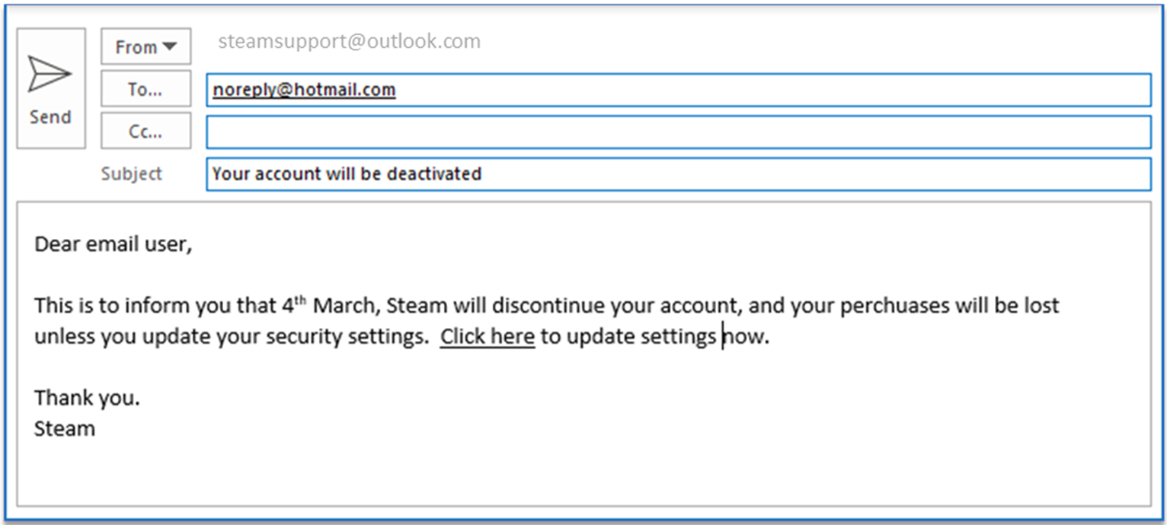

Social engineering threats: Phishing
An online fraud technique designed to trick computer users into giving away personal information such as:
Usernames
Passwords
Credit/debit card details
Perpetrators disguise themselves by imitating a trusted company or institution via email or a fake website.

Slide 4
Social engineering threats: Pharming
Pharming is a form of attack that sends or redirects a user to a fake website designed to look identical to the real thing when they type in a genuine web address.
Malicious code is installed on the user’s computer, a website host or even a DNS host to redirect them to the fake site.
Unlike phishing, the user doesn’t need to take any action for the redirect to be initiated.

Slide 5


Social engineering threats: Blagging (pretexting)
The act of creating and using an invented scenario to engage a targeted victim in a manner that increases the chance they will divulge information or perform actions that would be unlikely in ordinary circumstances.

Slide 6
Social engineering threats: Blagging (pretexting)
The act of creating and using an invented scenario to engage a targeted victim in a manner that increases the chance they will divulge information or perform actions that would be unlikely in ordinary circumstances.
Preventing blagging
Methods used to obtain information can be convincing. People often lack the required knowledge of how to spot blagging attempts and what questions should be asked.

Slide 7

Social engineering threats: Baiting
The promise of cash or goods that people with malicious intent use to entice victims – e.g., offering free music or movie downloads to trick users into revealing their login credentials.
Baiting attacks are not restricted to online scams. Attackers also focus on exploiting humans’ curiosity of physical media.
July 2018
KrebsOnSecurity reported an attack campaign targeting government agencies in the US.
The perpetrators sent out Chinese-postmarked envelopes containing a letter and a CD.
The aim was to pique recipients’ curiosity so they would load the CD and inadvertently infect their computers with malware.

Slide 8
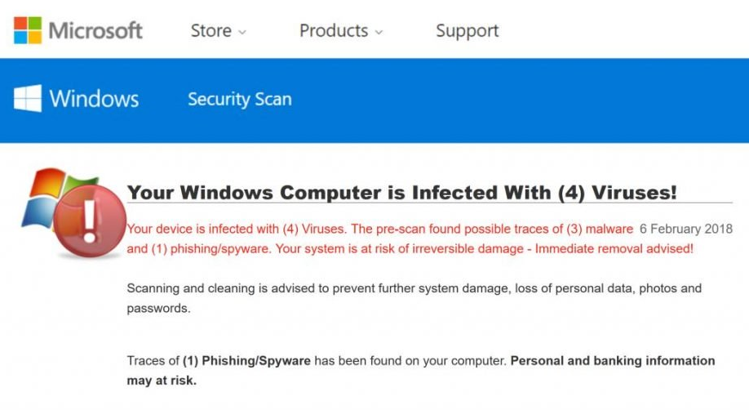
Social engineering threats: Quid pro quo
Very similar to baiting, except the benefit is usually in the form of a service as opposed to cash or goods.
Quid pro quo means something for something.
Quid pro quo attacks promise a benefit in exchange for information.
“You computer seems infected…”
“…don’t worry we can fix that right away for you…”
“…all I need is your credentials…”

Slide 9

Social engineering
The art of manipulating people so they give up confidential information.
Phishing: Sending emails purporting to be from reputable companies to incite people to reveal personal information.
Pharming: A form of attack that sends or redirects a user to a fake website designed to look identical to the real thing when they type in a genuine web address.
Blagging: The act of creating and using an invented scenario to engage a targeted victim in a manner that increases the chance they will divulge information or perform actions that would be unlikely in ordinary circumstances.
Baiting: Includes the promise of cash or goods that people with malicious intent use to entice victims – e.g., offering a free music or movie downloads to trick users into handing over their login credentials.
Quid pro quo: Quid pro quo means something for something. Very similar to baiting, except the benefit is usually in the form of a service as opposed to cash or goods. Quid pro quo attacks promise a benefit in exchange for information.
The best way to protect people from all forms of social engineering is good education and training in:
How to spot a fake email.
Knowing what questions to ask.
Never giving out personal details unless you are absolutely sure.

Slide 10


